Slide 1
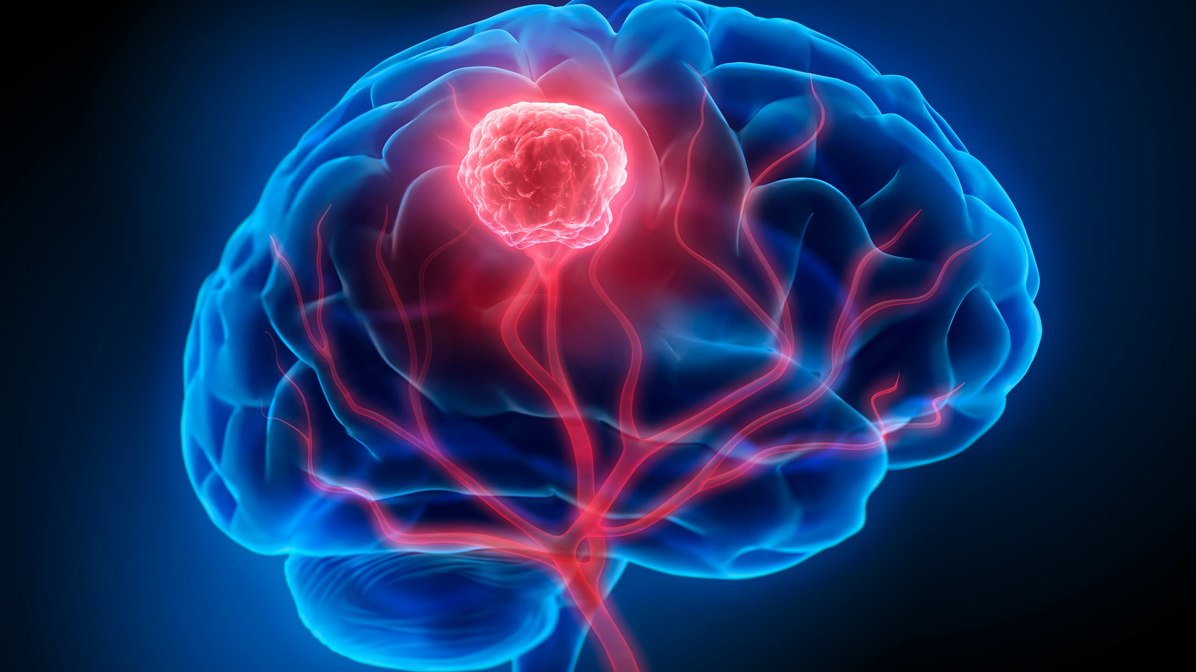
Brain Tumor Segmentation Using Deep Learning
Machine learning II
Tornike Jikhvashvili

Slide 2
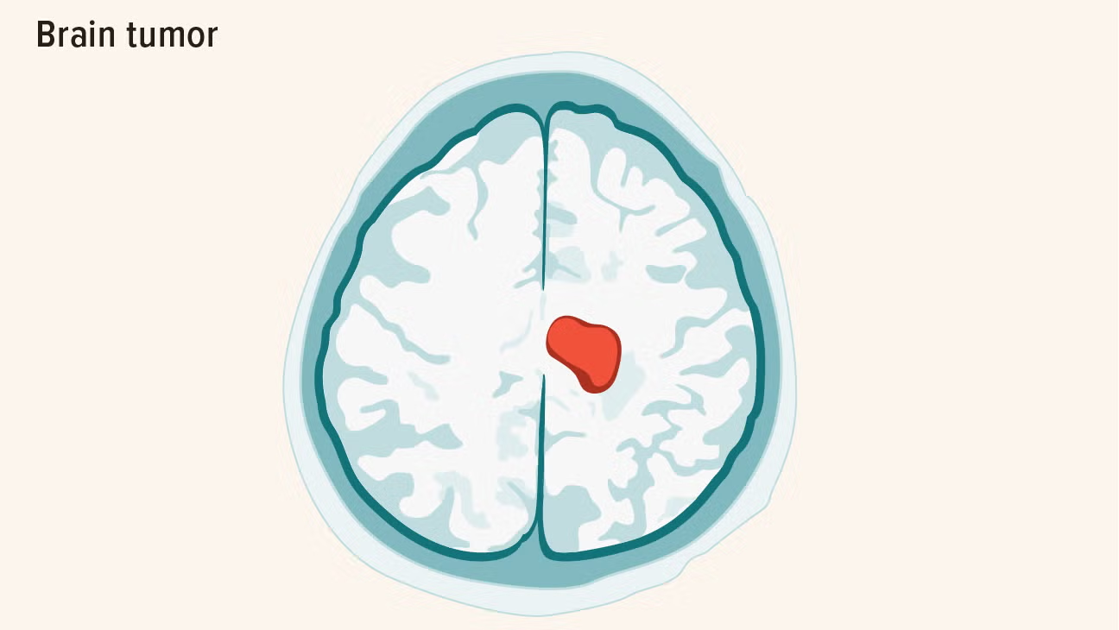
Problem Definition
What is Brain Tumor Segmentation?
Automatically identifying and outlining tumor regions in brain MRI scans.
Converting medical images into precise pixel-level tumor masks
Why is it Challenging?
Irregular tumor shapes - no standard size or boundary patterns
Variable intensities - tumors appear differently across MRI modalities
Complex anatomy - tumors can be in different brain regions

Slide 3
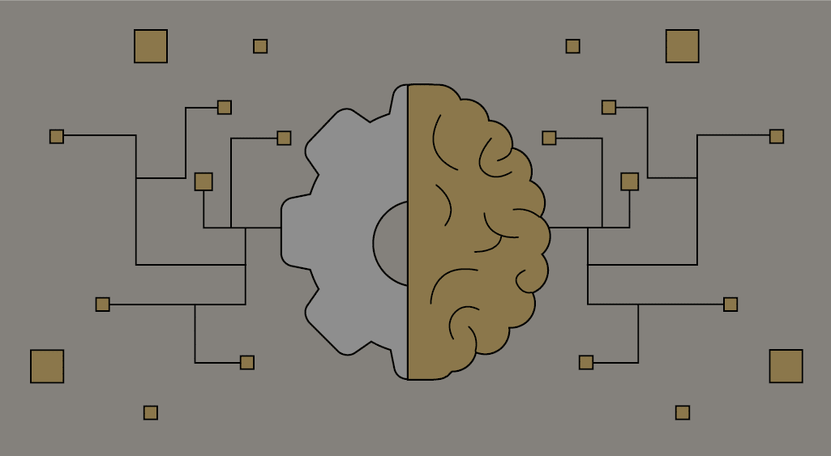
Motivation
Clinical impact
700,000+ new brain tumor cases each year
Early detection is critical for treatment success and patient survival
Time-sensitive diagnosis - delays can worsen patient outcomes
Limitations
Manual segmentation takes 3-4 hours per patient
Radiologist fatigue leads to inconsistent results
Limited availability of expert neuroradiologists
Subjective interpretation
Benefits of automation
Speed
Consistency
Scalability
Objectivity
Earlier treatment

Slide 4
Dataset - BraTS 2020
Brain Tumor Segmentation Challenge
International benchmark dataset for brain tumor segmentation
369 multi-institutional cases with expert annotations
High-grade glioma patients - most aggressive brain tumor type
Multi-Modal MRI Data
T1: Native T1-weighted - shows brain anatomy
T1ce: T1-weighted with contrast enhancement - highlights active tumor
T2: T2-weighted - shows tumor and surrounding edema
FLAIR: Fluid-attenuated inversion recovery - suppresses healthy tissue signal
Ground Truth Labels
Expert annotations by neuroradiologists
Pixel-level segmentation masks
Original multi-class labels: enhancing tumor, tumor core, whole tumor, healthy tissue
Data Characteristics
Image size: 240×240×155 voxels per modality
Standardized preprocessing - skull-stripped, co-registered
High quality medical-grade imaging data

Slide 5
Methodology Overview
Normalization
min-max normalization to scale the pixel values to a 0-1 range
Optimizers: Adam, AdamW, SGD
Loss: Dice+BCE
LR: 0.0005, 0.005
Epoch: 50
Batch size: 6
Binary vs. Multi-Class Segmentation
Original BraTS: 4-class segmentation (enhancing tumor, tumor core, whole tumor, background)
My approach: Binary classification (tumor vs. background)
2D Slice-Based Approach
Converting 3D volumes to 2D slices for training and inference
Slices processed independently rather than full 3D volume
Data Augmentation
Random Rotation, Random Flipping, Random Brightness and Contrast Adjustment

Slide 6
Models that I used
U-Net | Res-U-Net
Core Idea: Standard Encoder-Decoder with long-range skip connections. | Core Idea: Standard U-Net with Residual Blocks for better gradient flow.
Key Components
A "downsampling path" that extracts high-level features. | R- A "downsampling path" that extracts high-level features
An "upsampling path" that reconstructs the segmentation mask. | - An "upsampling path" that reconstructs the segmentation mask.
"Skip connections" that merge features from the downsampling path directly to the upsampling path. | Residual (or shortcut) connections within the convolutional blocks.

Slide 8
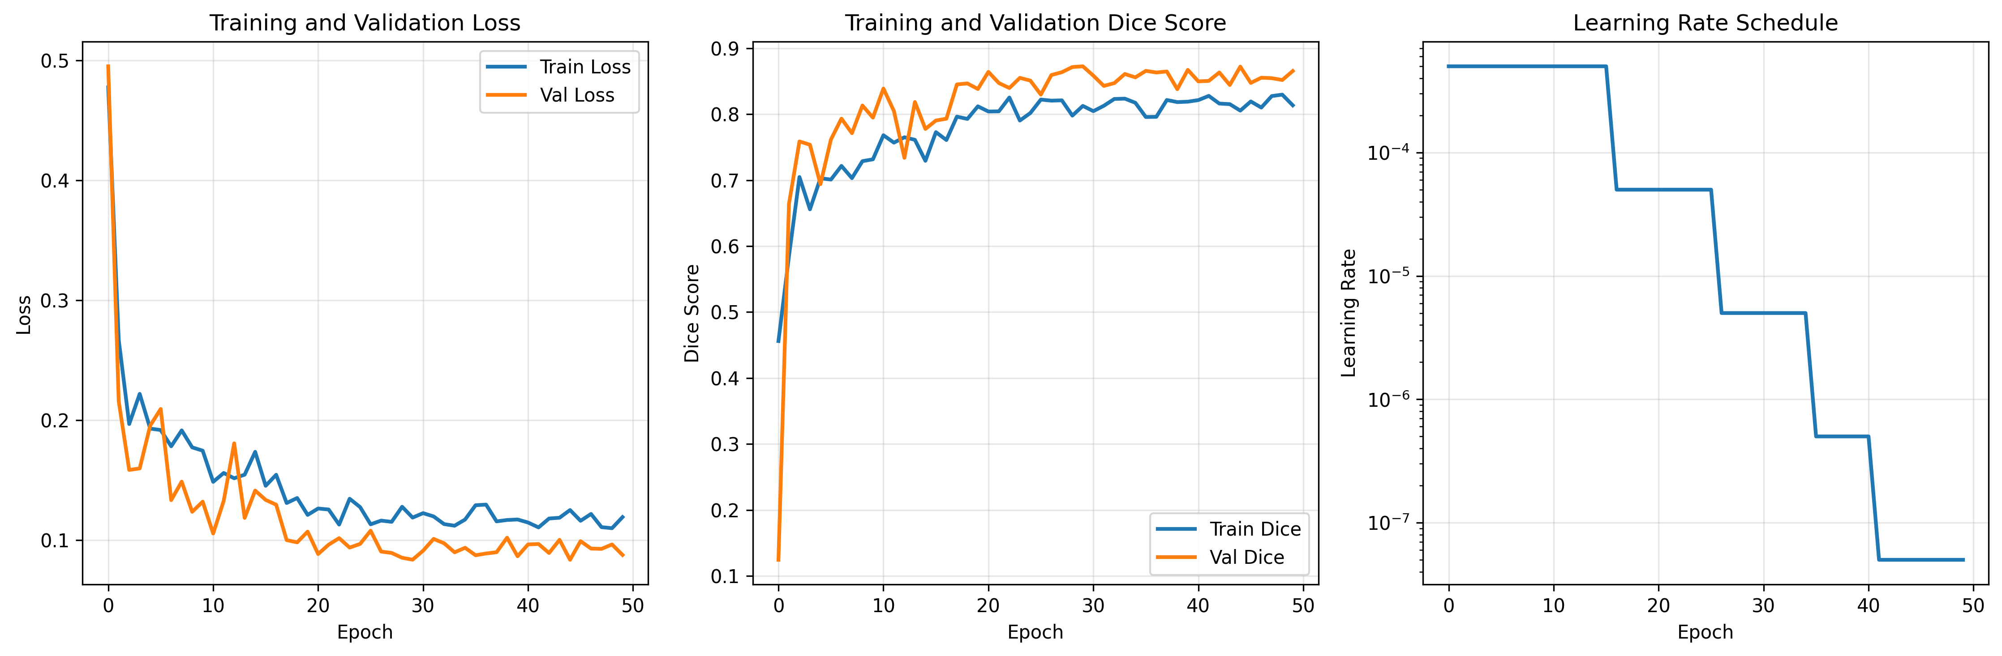

Slide 9
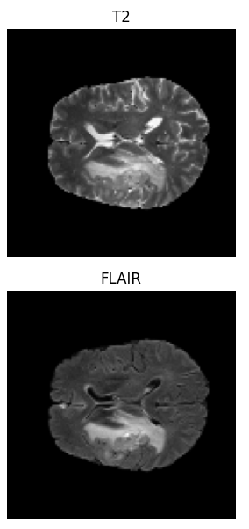
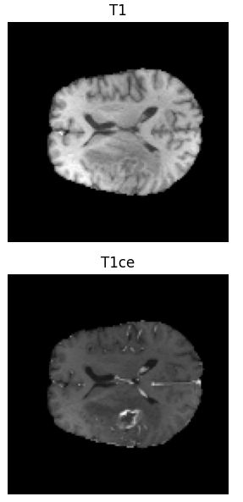
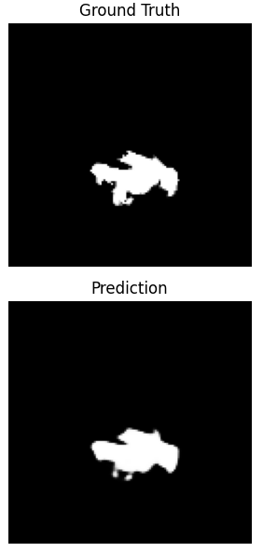

Slide 10

Potential improvements
Transition to 3D segmentation
Multi-class segmentation
More advance architectures

